Slide 1


Slide 2
De Morgan’s Theorems
CIT,2- Year ELT-II

Slide 3
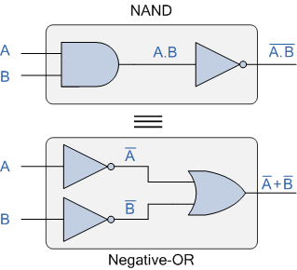
De Morgan’s First Theorem
De Morgan’s First theorem proves that when two (or more) input variables are AND and negated, they are equivalent to the OR of the complements of the individual variables. Thus the equivalent of the NAND function will be a negative-OR function, proving that A.B = A+B. We can show this operation using the following table.
CIT,2- Year ELT-II

Slide 4
Inputs |  | Truth Table Outputs For Each Term
B | A | A.B | A.B | A | B | A + B
0 | 0 | 0 | 1 | 1 | 1 | 1
0 | 1 | 0 | 1 | 0 | 1 | 1
1 | 0 | 0 | 1 | 1 | 0 | 1
1 | 1 | 1 | 0 | 0 | 0 | 0
CIT,2- Year ELT-II

Slide 5
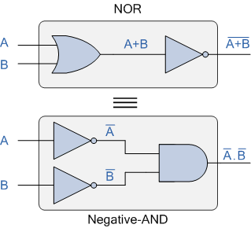
De Morgan’s Second Theorem
De Morgan’s Second theorem proves that when two (or more) input variables are OR and negated, they are equivalent to the AND of the complements of the individual variables. Thus the equivalent of the NOR function is a negative-AND function proving that A+B = A.B, and again we can show operation this using the following truth table.
CIT,2- Year ELT-II

Slide 6
Inputs |  | Truth Table Outputs For Each Term
B | A | A+B | A+B | A | B | A . B
0 | 0 | 0 | 1 | 1 | 1 | 1
0 | 1 | 1 | 0 | 0 | 1 | 0
1 | 0 | 1 | 0 | 1 | 0 | 0
1 | 1 | 1 | 0 | 0 | 0 | 0
CIT,2- Year ELT-II

Slide 7
CIT,2- Year ELT-II

Slide 8
CIT,2- Year ELT-II

